Slide 1



University Institute of Engineering
DEPARTMENT OF COMPUTER SCIENCE & ENGINEERING
Subject Name: Software Engineering
Subject Code: 23CST-206
Software Testing
Er. Jagmeet Kaur
E8387
ASSISTANT PROFESSOR
CSE
DISCOVER . LEARN . EMPOWER

Slide 2
Chapter-7 Software Testing
Basis Path Testing

Slide 3
Basis Path Testing
Basis path testing, a structured testing or white box testing technique used for designing test cases intended to examine all possible paths of execution at least once.
Creating and executing tests for all possible paths results in 100% statement coverage and 100% branch coverage.

Slide 4
Basis Path Testing
Basis Path Testing is a white-box testing technique based on the control structure of a program or a module.
Using this structure, a control flow graph is prepared and the various possible paths present in the graph are executed as a part of testing. Therefore, by definition,
Basis path testing is a technique of selecting the paths in the control flow graph, that provide a basis set of execution paths through the program or module.

Slide 5
Basis Path Testing
Since this testing is based on the control structure of the program, it requires complete knowledge of the program’s structure. To design test cases using this technique, four steps are followed :
Construct the Control Flow Graph
Compute the Cyclomatic Complexity of the Graph
Identify the Independent Paths
Design Test cases from Independent Paths

Slide 6
Basis Path Testing (Notations)
Control Flow Graph – A control flow graph (or simply, flow graph) is a directed graph which represents the control structure of a program or module. A control flow graph (V, E) has V number of nodes/vertices and E number of edges in it. A control graph can also have :
Junction Node – a node with more than one arrow entering it.
Decision Node – a node with more than one arrow leaving it.
Region – area bounded by edges and nodes (area outside the graph is also counted as a region.).

Slide 7
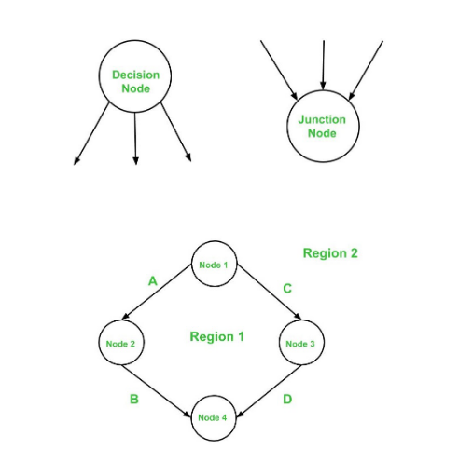

Slide 8
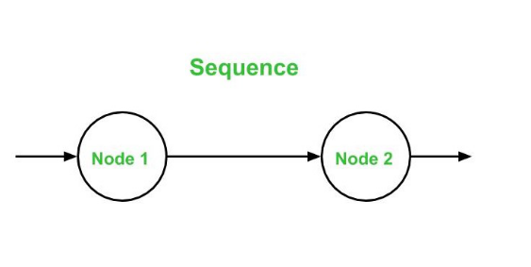
Notations
Below are the notations used while constructing a flow graph :
Sequential Statements –

Slide 9
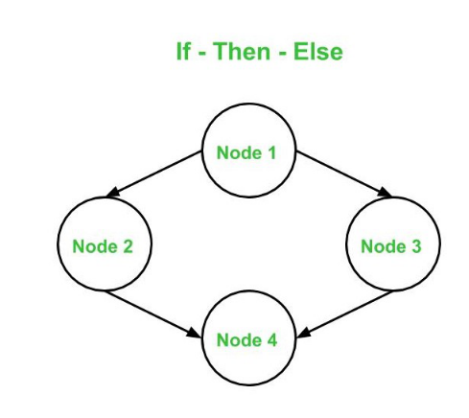
Notations
If – Then – Else –

Slide 10
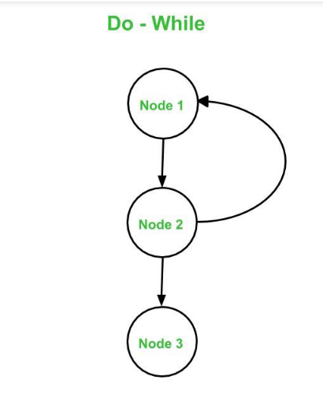
Notations
Do – While –

Slide 11
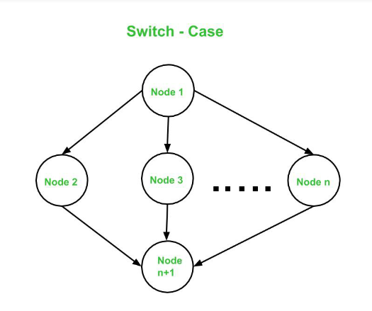
Notations
Switch – Case

Slide 12
Cyclomatic Complexity
The cyclomatic complexity V(G) is said to be a measure of the logical complexity of a program. It can be calculated using three different formulae :
Formula based on edges and nodes :V(G) = e - n + 2*P Where, e is number of edges, n is number of vertices, P is number of connected components.
For example, consider first graph given above,
where, e = 4, n = 4 and p = 1 So, Cyclomatic complexity V(G) = 4 - 4 + 2 * 1 = 2

Slide 13
Cyclomatic Complexity
Formula based on Decision Nodes :
V(G) = d + P where, d is number of decision nodes, P is number of connected nodes.
For example, consider first graph given above,
where, d = 1 and p = 1 So, Cyclomatic Complexity V(G) = 1 + 1 = 2

Slide 14
Cyclomatic Complexity
Formula based on Regions :V(G) = number of regions in the graph For example, consider first graph given above,
Cyclomatic complexity V(G) = 1 (for Region 1) + 1 (for Region 2) = 2
Hence, using all the three above formulae, the cyclomatic complexity obtained remains same. All these three formulae can be used to compute and verify the cyclomatic complexity of the flow graph.

Slide 15
Independent Paths
An independent path in the control flow graph is the one which introduces at least one new edge that has not been traversed before the path is defined.
The cyclomatic complexity gives the number of independent paths present in a flow graph.
This is because the cyclomatic complexity is used as an upper-bound for the number of tests that should be executed in order to make sure that all the statements in the program have been executed at least once.

Slide 16
Advantages
Basis Path Testing can be applicable in the following cases:
More Coverage – Basis path testing provides the best code coverage as it aims to achieve maximum logic coverage instead of maximum path coverage. This results in an overall thorough testing of the code.
Maintenance Testing – When a software is modified, it is still necessary to test the changes made in the software which as a result, requires path testing.
Unit Testing – When a developer writes the code, he or she tests the structure of the program or module themselves first. This is why basis path testing requires enough knowledge about the structure of the code.

Slide 17
Advantages
Integration Testing – When one module calls other modules, there are high chances of Interface errors. In order to avoid the case of such errors, path testing is performed to test all the paths on the interfaces of the modules.
Testing Effort – Since the basis path testing technique takes into account the complexity of the software (i.e., program or module) while computing the cyclomatic complexity, therefore it is intuitive to note that testing effort in case of basis path testing is directly proportional to the complexity of the software or program.

Slide 18
References
https://www.tutorialspoint.com/software_testing_dictionary/basis_path_testing.htm
https://www.geeksforgeeks.org/basis-path-testing-in-software-testing/
https://www.guru99.com/basis-path-testing.html
https://reqtest.com/testing-blog/basis-path-testing/

Slide 19
THANK YOU

